Slide 1
Introduction to Language and Tools

Slide 2
Contents
Objectives
To introduce Java Technologies and the Java language
Take at look around Eclipse
Contents
The Java and C# story
Key framework features
Basic code construction
Your first application
Hands on Labs
Create and build a simple program

Slide 3

What is Java?
Originally named ‘Oak’ (1991)
Sun (MicroSystems) project lead by James Gosling
Created for enabling devices with different CPU’s to share s/w
Java was used for web pages with multi-media components
So, what is Java?
A programming language
A development environment
An application environment
A deployment environment
Java Development Kit (JDK)
Java runtime Environment (JRE)
Java SDK (Software Development Kit) Java’s Framework Class Library for all apps
Notes:
Java Technology is one way of implementing applications written in the Java programming language.
The syntax of the Java programming language is similar to C++ syntax and the semantics are similar to SmallTalk semantics. You can use the Java programming language to create all kinds of applications that you could create using any conventional programming language.
As a development environment, Java technology provides the programmer with the Java Development Kit (JDK), a large suite of tools: a compiler, an interpreter, a Documentation generator, a class file packaging tool, and so on.
Java applications are typically standalone programs. They are typically general-purpose programs that run on any machine where the Java runtime environment (JRE) is installed.
The main deployment environment provides the JRE, supplied by the Java SDK (Software Development Kit) and contains the complete set of class files for all of the Java packages, including basic language classes, GUI component classes, an advanced Collections API and so on.

Slide 4
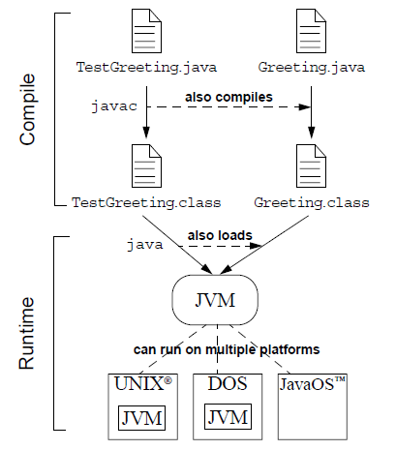
Compiling and Running a Java App
public class Program {
public static void main(String[ ] args) {
... ...
} // end of main method
}
Program.class Byte code
Notes:
The slide above illustrates how Java technology programs can be compiled and then run on the Java virtual machine (JVM). There are many implementations of the JVM on different hardware and operating system platforms.
Consider an application consisting of two classes, ClassA and ClassB which are defined in files called ClassA.java and ClassB.java respectively. When you have created a source file, you can compile the class with the following command:
javac classname.java
If the compiler does not return any messages, the new files ClassA.class and ClassB.class are stored in the same directory as the source file. These .class files contain semi-compiled java byte code.
To run your application, use the Java interpreter. The executables for the Java technology tools (javac, java, javadoc, and so on) are always located in a ‘bin’ directory.
java ClassA
Note: If any errors are encountered, then the Java Technology software will report the specific error:
Compile-time errors – generated by the java compiler (javac.exe)
Run-time Errors – generated by the JVM (java.exe)
A Java Virtual Machine (JVM) is:
An imaginary machine that is implemented by emulating it in software on a real machine. Code used by the Java virtual machine is stored in .class files, each of which contains code for at most one public class.
The JVM supports Garbage Collection, which is concerned with recovering computer memory automatically, when the data that memory holds is no longer required.
The JVM provides code security, by ensuring that the code loaded does not contain any invalid Java instructions.
A Java virtual machine (JVM) interprets compiled Java binary code (called bytecode) for a computer's processor (or "hardware platform") so that it can perform a Java program's instructions. Java was designed to allow application programs to be built that could be run on any platform without having to be rewritten or recompiled by the programmer for each separate platform. A Java virtual machine makes this possible because it is aware of the specific instruction lengths and other particularities of the platform.^{[2]}
JIT compiling, not interpreting, is used in most JVMs today to achieve greater speed.

Slide 5
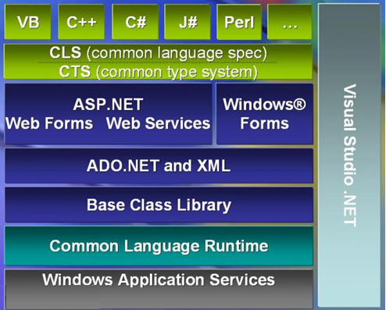
What is C#?
One of .NET languages amongst 30+ others
.NET was first called Next Generation Windows Services (NGWS)
Released on 13 February 2002
Aim was to create managed components
Notes:
Why was .NET created? In the old days, developers wrote apps in C, C++, VB6 etc. These apps had one thing in common, they all generated code for MS-Windows OS which interacted directly on it. Windows is not the most secure OS you would think of and coupling compiled code with any OS is not wise. The compiled code (generated by .NET is also managed by .NET before being executed on the OS. This is why .NET is considered a safer framework for compiling and running apps.
C# is not the only .NET language. There are over 30 others but all compile to the same Byte code which in the world of .NET is called the Common Intermediate Language (CIL). CIL is operating system agnostic which means it can (theoretically) run on any OS that has a suitable Common Language Runtime and .NET framework. .NET provides classes as part of its Framework Class Library (Base library or FCL) for creating database, Web apps amongst many others. Visual Studio.NET is the primary tool we use to create such applications.

Slide 6
Compiling and Running a C# App
Program.cs
QALibrary.cs
public class Program {
public static void Main(String[ ] args) {
... ...
} // end of main method
}
references
Program.exe
CIL
QALibrary.dll
Program.exe CIL code (Common Intermediate Language)
CLR
Windows
Linux
Notes:
The slide above illustrates how .NET programs can be compiled and then run on an OS using the Common Language Runtime (CLR)
The .NET Framework provides many services for making your programs more secure and it has components to take care of low level tasks such as freeing memory by using a component called Garbage Collector (GC). It would not be right to discuss all services provided by .NET at this stage as you'll discover many of its features during the next few courses.

Slide 7
Java Packages
Used to group types and avoid naming conflicts
Affects location of the compiled code
One of these at top of every file
package qa.apprentice;
public class Program {
public static void main(String[] args ) {
. . .
} // end of method Main
} // end of class Program
package qa.hr;
public class Timetable {
// code
}
package qa.apprentice;
public class Timetable {
// code
}
Notes:
Each class may belong to only one package. You should always place your classes inside a package that you define, otherwise it will belong to a default package which may result in naming conflicts with other classes.
When a class belongs to a package, the full name of that class includes the dot separated package name. So if Program belongs to qa.apprentice, then its fully qualified name is qa.apprentice.Program.
We can avoid typing the fully qualified name by using an import statement(s) described soon.
There are many ways to group classes into meaningful packages.
There is no right or wrong way; but a common technique is to group classes into a package by semantic similarity.
For example, a QA software system could contain a set of domain objects (such as hr and apprentice), a set of classes such as Program, and Timetable and others for things like GUI panels (not included on the slide) that are used to create the main data entry application. All of these packages are contained in the top-level package called QA. Please note, packages enable us to create two distinct classes called Timesheet, one belonging to the qa.hr package and the other to qa. Apprentice package. In the old days, we had to come up with different names for these such as HrTimesheet and ApprenticeTimesheet!
You'll learn more about defining and using packages at a later date in this course.

Slide 8
Java Packages and import statements
package qa.apprentice; import java.io.*;
public class Program {
public static void main(String[ ] args) {
TimeTable qaaTimetable;
FileReader fr;
... using ‘fr’ and qaaTimeTable ...
}
}
Notes:
This class is effectively named qa.apprentice.Program
Each class may belong to only one package. You always place your classes inside a package that you define, otherwise you can find that you will get naming conflicts with other classes.
On this course the package will tend to be known as ‘Starter’ but with a separate ‘Starter’ package existing inside each project, and a separate project created for each chapter.
A separate package called ‘Solution’ will exist for each chapter’s project containing solution code that might be useful for review post-course.
We can avoid typing the fully qualified name of a class when using the class elsewhere by using an import statement. The two import examples above show the List class of package java.util being made available and also all classes of the java.io package.

Slide 9
C# namespaces
Used to group types and avoid naming conflicts
Does not affect the location of compiled assembly ( .exe/ .dll )
One of these at top of every file
namespace QA.Apprentice{
public class Program {
public static void Main(string[] args ) {
. . .
} // end of method Main
} // end of class Program
} // end of namespace
namespace QA.Hr{
public class Timetable {
// code
}
}
namespace QA.Apprentice{
public class Timetable {
// code
}
}
Notes:
Each class may belong to only one namespace. You should always place your classes inside a namespace that you define, otherwise it will belong to a default package which may result in naming conflicts with other classes.
When a class belongs to a namespace, the full name of that class includes the dot separated package name. So if Program belongs to QA.Apprentice, then its fully qualified name is QA.Apprentice.Program.
We can avoid typing the fully qualified name by using an using statement(s) described soon.
There are many ways to group classes into meaningful packages.
There is no right or wrong way; but a common technique is to group classes into a package by semantic similarity.
For example, a QA software system could contain a set of domain objects (such as hr and apprentice), a set of classes such as Program, and Timetable and others for things like GUI panels (not included on the slide) that are used to create the main data entry application. All of these packages are contained in the top-level package called QA. Please note, namespaces enable us to create two distinct classes called Timesheet, one belonging to the QA.Hr package and the other to QA. Apprentice package. In the old days, we had to come up with different names for these such as HrTimesheet and ApprenticeTimesheet!
You'll learn more about defining and using namespaces at a later date in this course.

Slide 10
Using classes in other namespaces
using System.IO;
namespace QA.Apprentice
{ public class Program {
public static void Main(string[ ] args) {
TimeTable qaaTimetable;
... using the qaaTimetable instance...
}
}
}
Notes:
This class is effectively named QA.Apprentice.Program
If you wish to use classes in other namespaces you've two choices. Either type the full programmatic name such as QA.Hr.Timetable t = new QA.Hr.Timetable( ); or type "using QA.Hr" at the start of the page and then you're free to miss out the QA.Hr part like: Timetable t = new Timetable( );

Slide 11
Java and .NET history
Framework Technologies - key features
Basic code construction in Java and C#
packages and namespaces
How programs are compiled and run
Review

Slide 12
Hands On Labs
In this lab you will learn:
How to create and build and run a program
How to use an IDE to create an application
Compile code in Command line
Naming convention
The role of the main() method
The role of packages/namespaces
This lab forms the foundation for all the other labs. Please make sure you complete this lab and understand each step
Notes:
During this lab, you'll learn
How to write a standalone Java application, as is demonstrated by the Java example of the "Hello, World" program
How to compile a program using Eclipse and also by using the command line.
A Java application has an entry point called main(). Also, the execution of the Java program will end when the main() ends.
Names are case sensitive, so System is different from system
Statements are terminated with semi-colons
All code must be contained within a class definition

